Slide 1
A camera-based writing pad based on hand tracking algorithm
Computer science
12/8/2017
Team: Jiangnan Zou / Ke Zhao

Slide 2

Problem Definition
Handwriting input system is usually costly
"smooth" surface may leave users a horrible experience
a camera-based input system that recognizes the motion path of hand regardless of the surface meterials that plain is made of

Slide 3
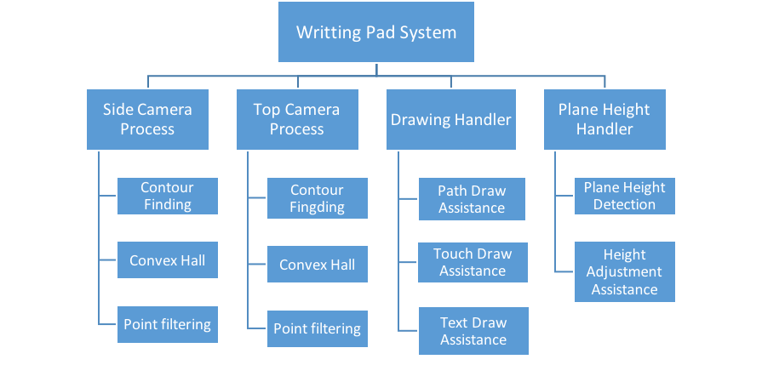
Program Structure

Slide 4
1.
Method and Implementation

Slide 5
Methods applying to fingertip detection
Skin color detection
Median blur (Median filter)
Dilation
Contour finding
Convex hull
Target point reducing
Target point filtering

Slide 6
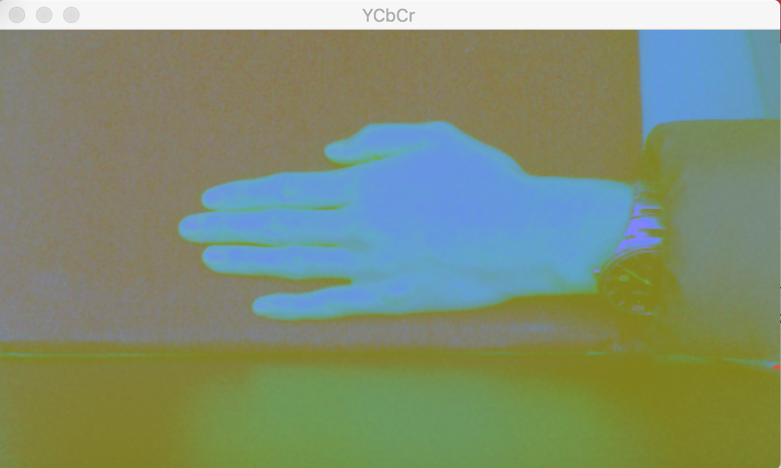
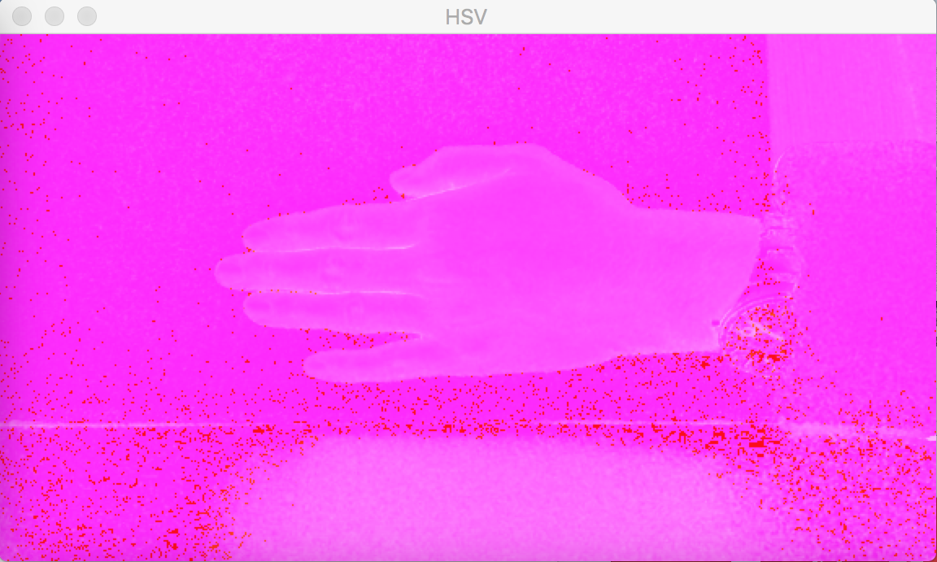
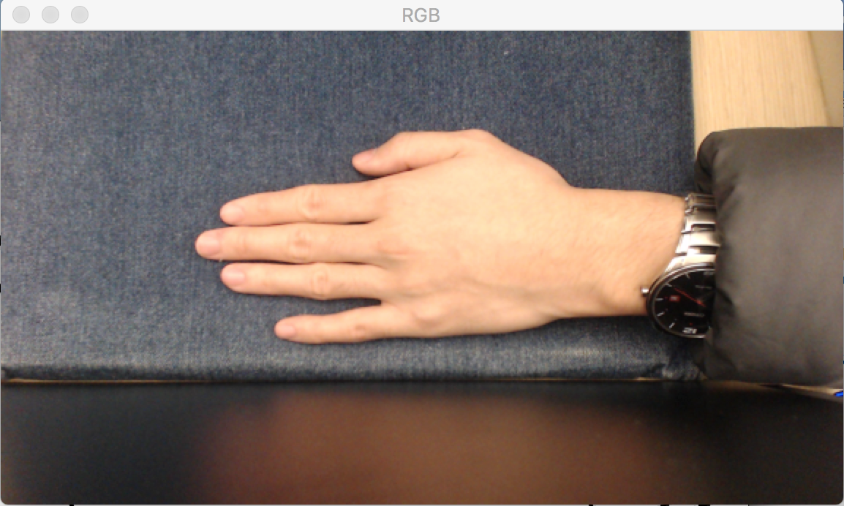
Skin color detection
RGB
HSV
YCbCr

Slide 7
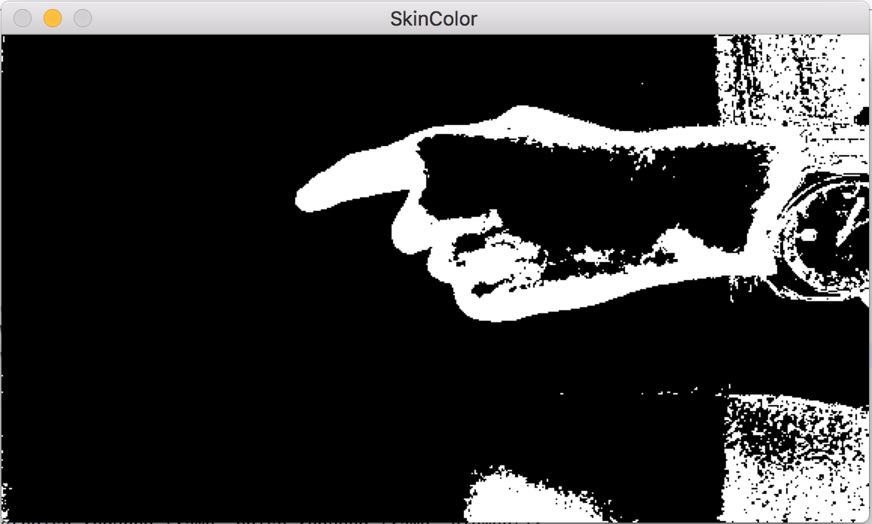
Processed Result after this step
Skin Color Detection

Slide 8
Median blur (Median filter)
move a kernel on the image pixel by pixel and replace the central element (pixel) of the overlapped kernel with the median of all the pixels within the kernel
Eliminate white noise

Slide 9
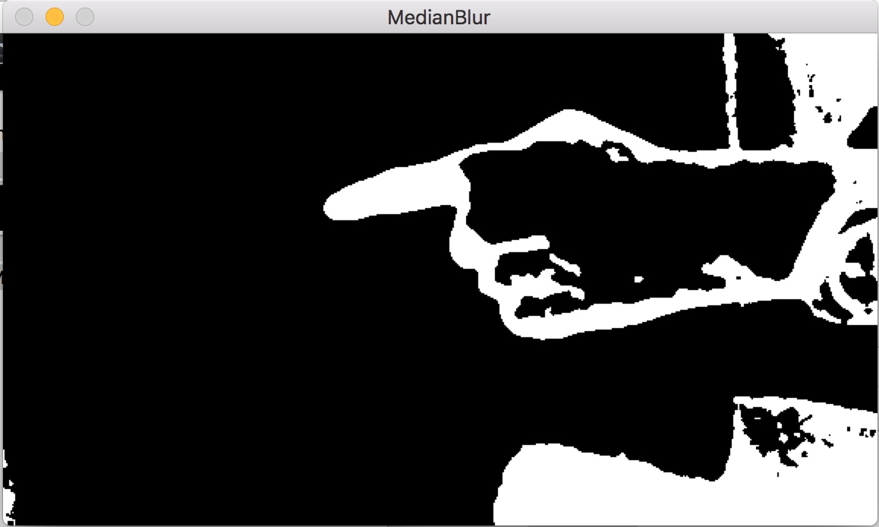
Processed Result after this step
Median Blur

Slide 10
Dilation
“dilate” the white region in an image
cause the bright region within an image to “grow”

Slide 11
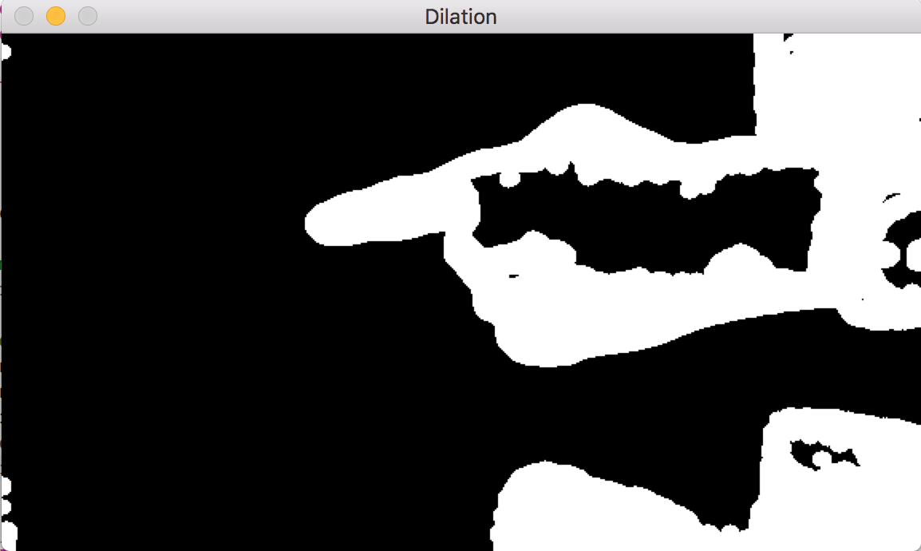
Processed Result after this step
Dilation

Slide 12
Contour finding
find the contour of each white region in the last processed result separately
Only process largest contour

Slide 13
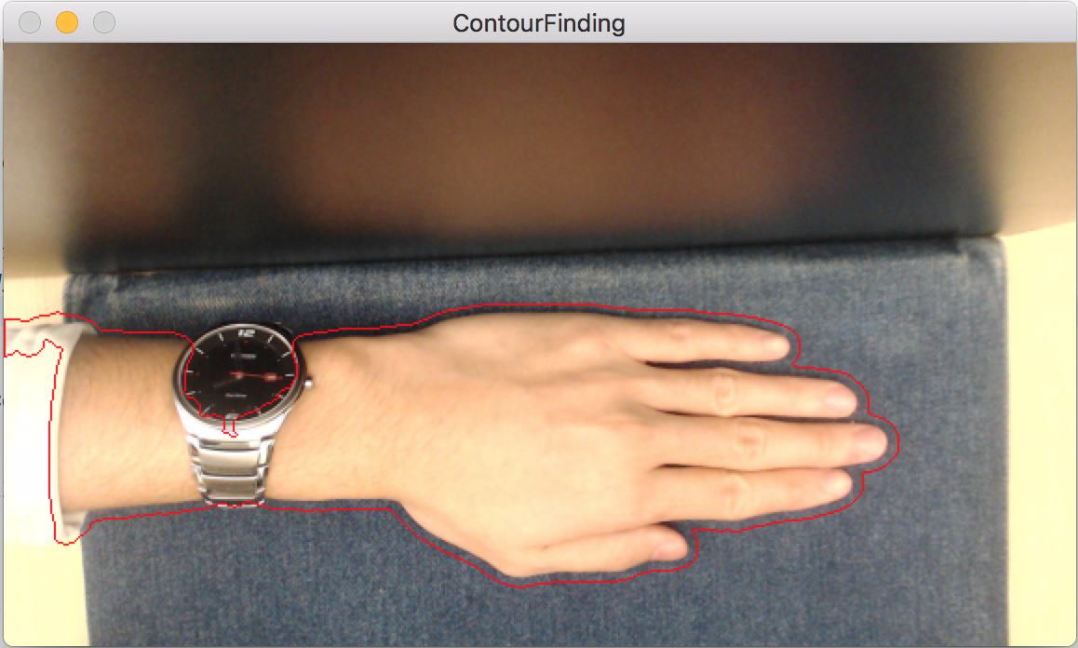
Processed Result after this step
Contour Finding

Slide 14
Convex hall
the smallest convex set that contains a set of points such that, if we trace a straight line from any pair of points in the set, that line must be also be inside the region.
Simplify
Complicated
Object

Slide 15
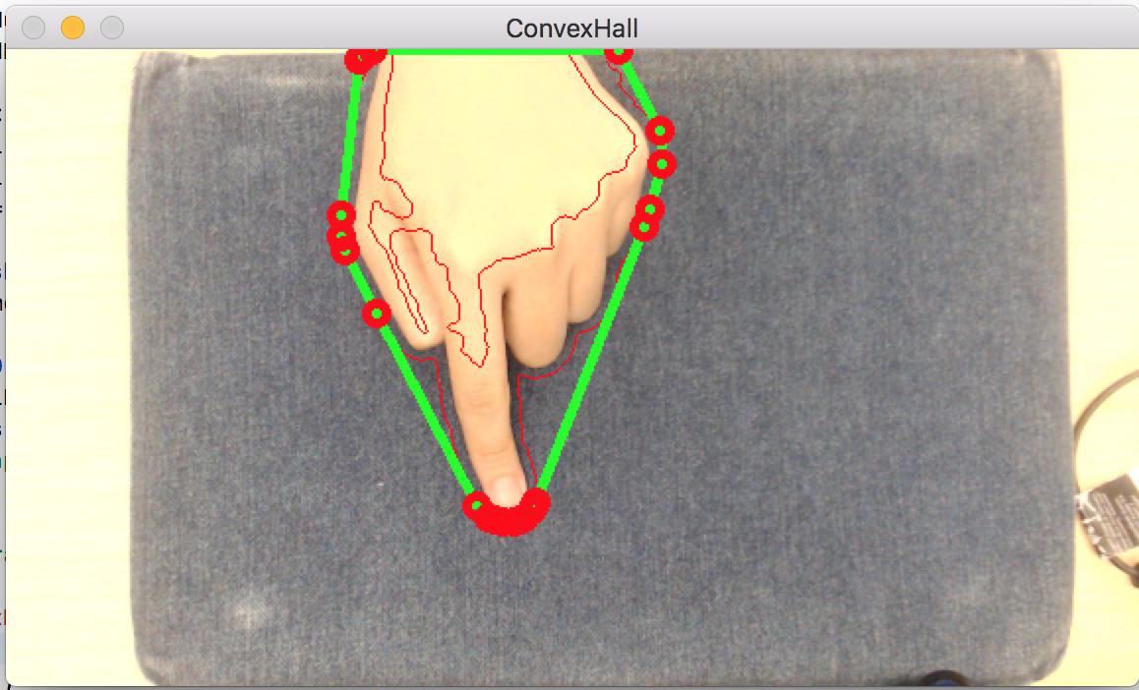
Processed Result after this step
Convex Hull

Slide 16
Target point reducing
reduce those congregated points to a single point
representing a small targeting region

Slide 17
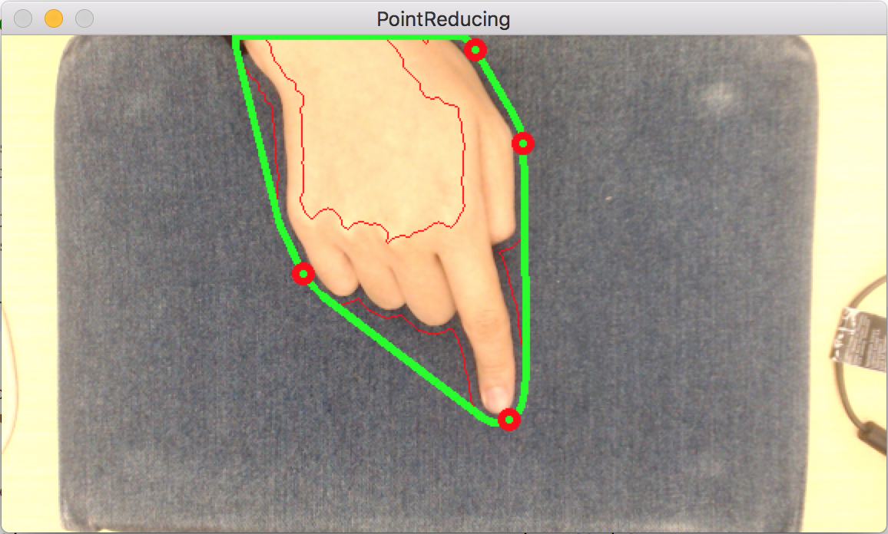
Processed Result after this step
Target Point Reducing

Slide 18
Target Point Filtering
Only consider the point of which the angle between itself and the center of contour region to be between a certain interval
· 50°~130° for top view
· -20°~-70° for side view
Only consider the point of which the height from the center of contour region to be between a certain interval
½ height of bounding box

Slide 19
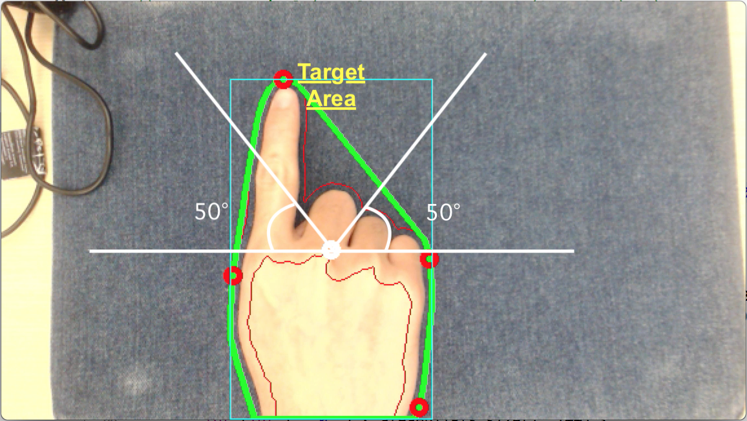
ANGLE CONSTRAINT
Target area is restricted by two rays originated form the center of bounding box showing in the picture

Slide 20
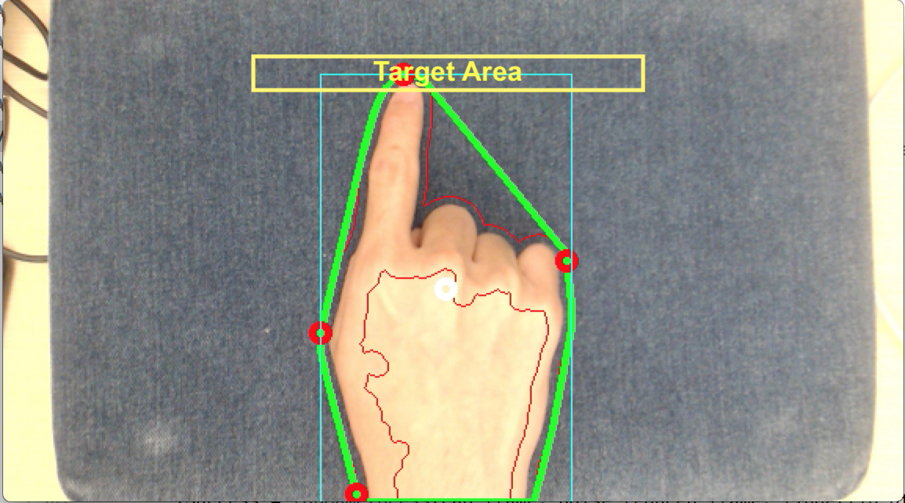
HEIGHT CONSTRAINT
Target area is restricted by the height from the center of contour region

Slide 21
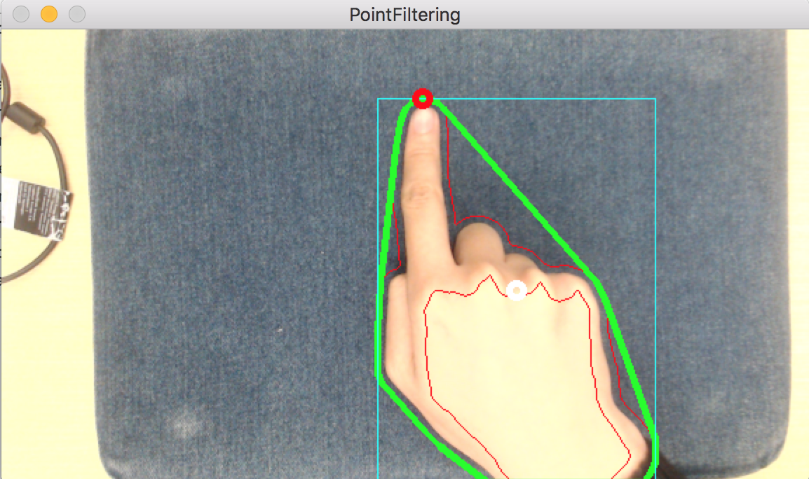
Processed Result after this step
Target Point Reducing

Slide 22
Methods applying to plane height detection:
Detect Region of Interest
HSV Color Conversion
Histogram Calculation
Back projection
Filter2D
Extract the Largest Contour
Draw contour and bounding box

Slide 23

Detect Region of Interest
find a small portion of similar color of the real objects. We specify a region of interest in the central lower part of image

Slide 24
HSV Color Conversion
After specifying the ROI, we need to transform both source image and ROI to HSV format. The range is given below.
H: [0, 180] S: [0, 256] V: [0, 256]

Slide 25
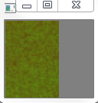
Histogram Calculation
we calculate the histogram of ROI as a parameter to find the all possible similar pixel in the image.

Slide 26
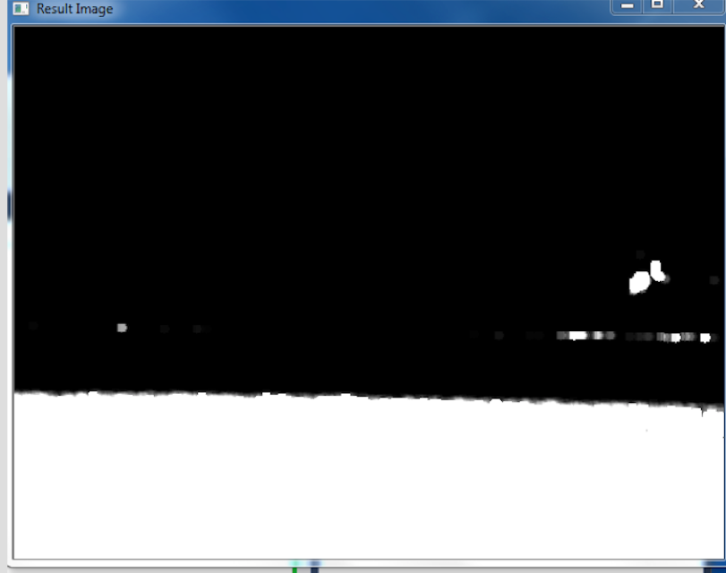
Back Projection
For Back Projection, we calculate the histogram model of a feature and then use it to find this feature in an image.

Slide 27
Filter2D
convolve the image with a disc kernel and apply threshold

Slide 28
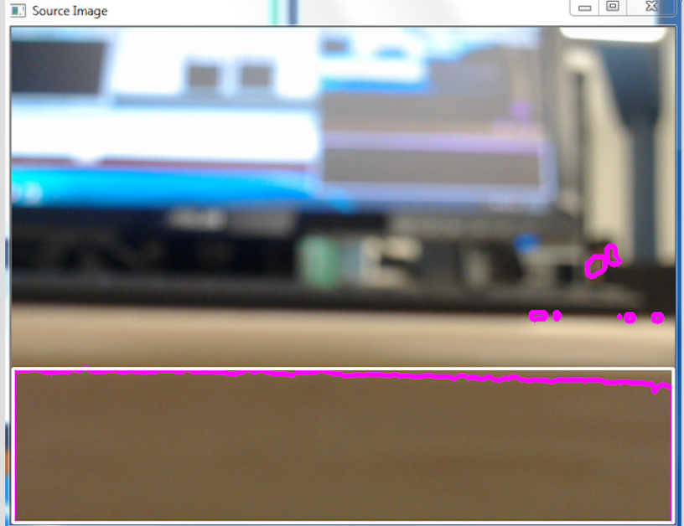
Contour and Bounding Box
iterate through contours and calculate each area of all contours.
assign the largest contour to the bounding rectangle

Slide 29
2.
Experiments and Results

Slide 30
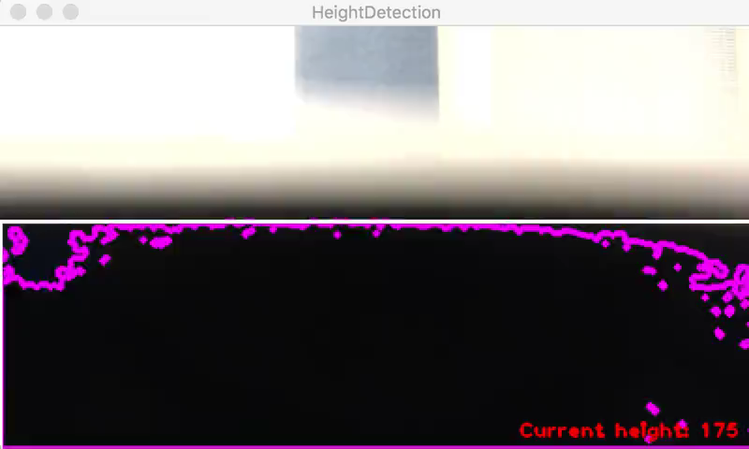
Plane height detection
from side camera view

Slide 31
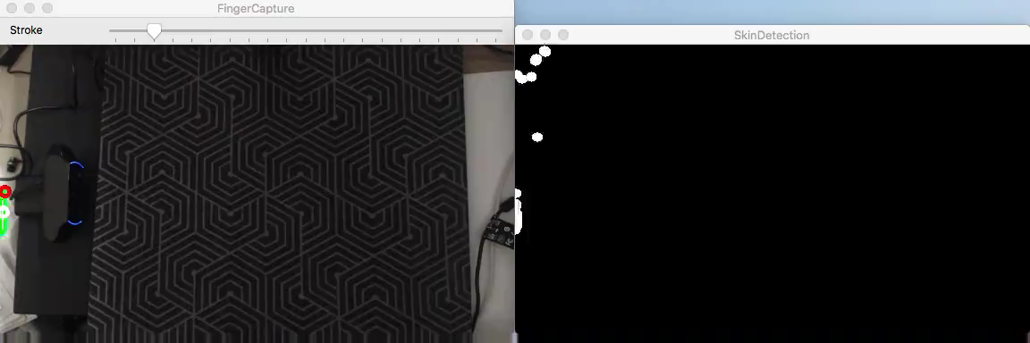
Accuracy of Recognition
from top camera view

Slide 32
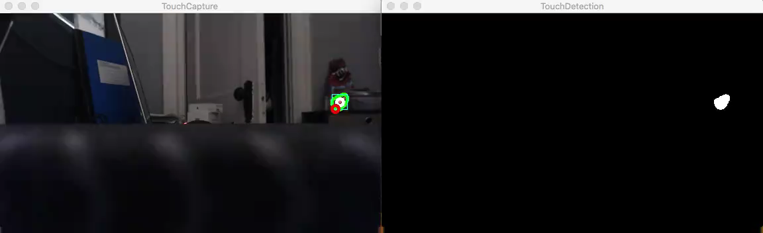
Accuracy of Recognition
from side camera view

Slide 33
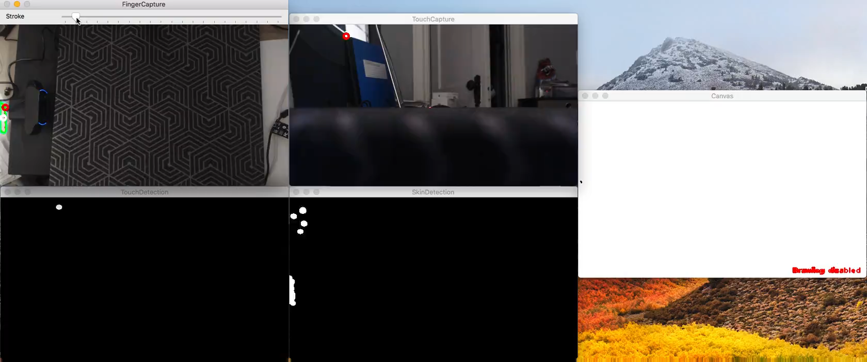
Combined results
and drawing effect

Slide 34
3.
Conclusions and Discussions

Slide 35
“the overall tracing result and accuracy of recognition is acceptable”
“the drawing function works well”
“inaccurate and unstable tracing points may occur within a short period of time”

Slide 36
Shortcomings
FRAME
RATE
The frame rate of processed image stream displaying in the window is not ideal.
DETECTION
METHOD
Since the only image capturing devices we possessed are two simple RGB cameras, introducing skin color detection is inevitable which may lead to a low accuracy.
REGION OF INTEREST
The height detection algorithm only assumes the desk is positioned in the region of interest, otherwise, it won’t detect desired regions.

Slide 37
Prospects
A revolutionary writing experience
An amazingly convenient interactive way
Automatically find the region of desk by training with dataset

Slide 38
THANKS!
Any questions?
Team: Jiangnan Zou / Ke Zhao
A camera-based writing pad based on hand tracking algorithm

